Slide 1
AMAZON FRESH ANALSIS

Slide 2
Task 1: Entity Relationship Diagram(ER): Customers and products table
Country
Age
Primemember
Name
Gender
SignupDate
State
City
CUSTOMER - CustomerID
Sub category
PricePerunit
SupplierID
Product Name
StockQuantity
Category
Products - ProductID

Slide 3
Task 1: Entity Relationship Diagram(ER): suppliers and orderdetails
SupplierName
City
State
Phone
Contact Person
OrderID
PriceperUnit
ProductID
Discount
Suppliers - SupplierID
Quantity
OrderDetails - OrderdetailsID

Slide 4
Task 1: Entity Relationship Diagram(ER): Orders Table
Deliver fee
orderdate
Order Amount
CustomerID
Discount
ORDERS - orderID

Slide 5
Task 1: Entity Relationship Diagram(ER): Reviews table
Deliver fee
ProductID
Review text
CustomerID
Rating
Reviews - ReviewD

Slide 6
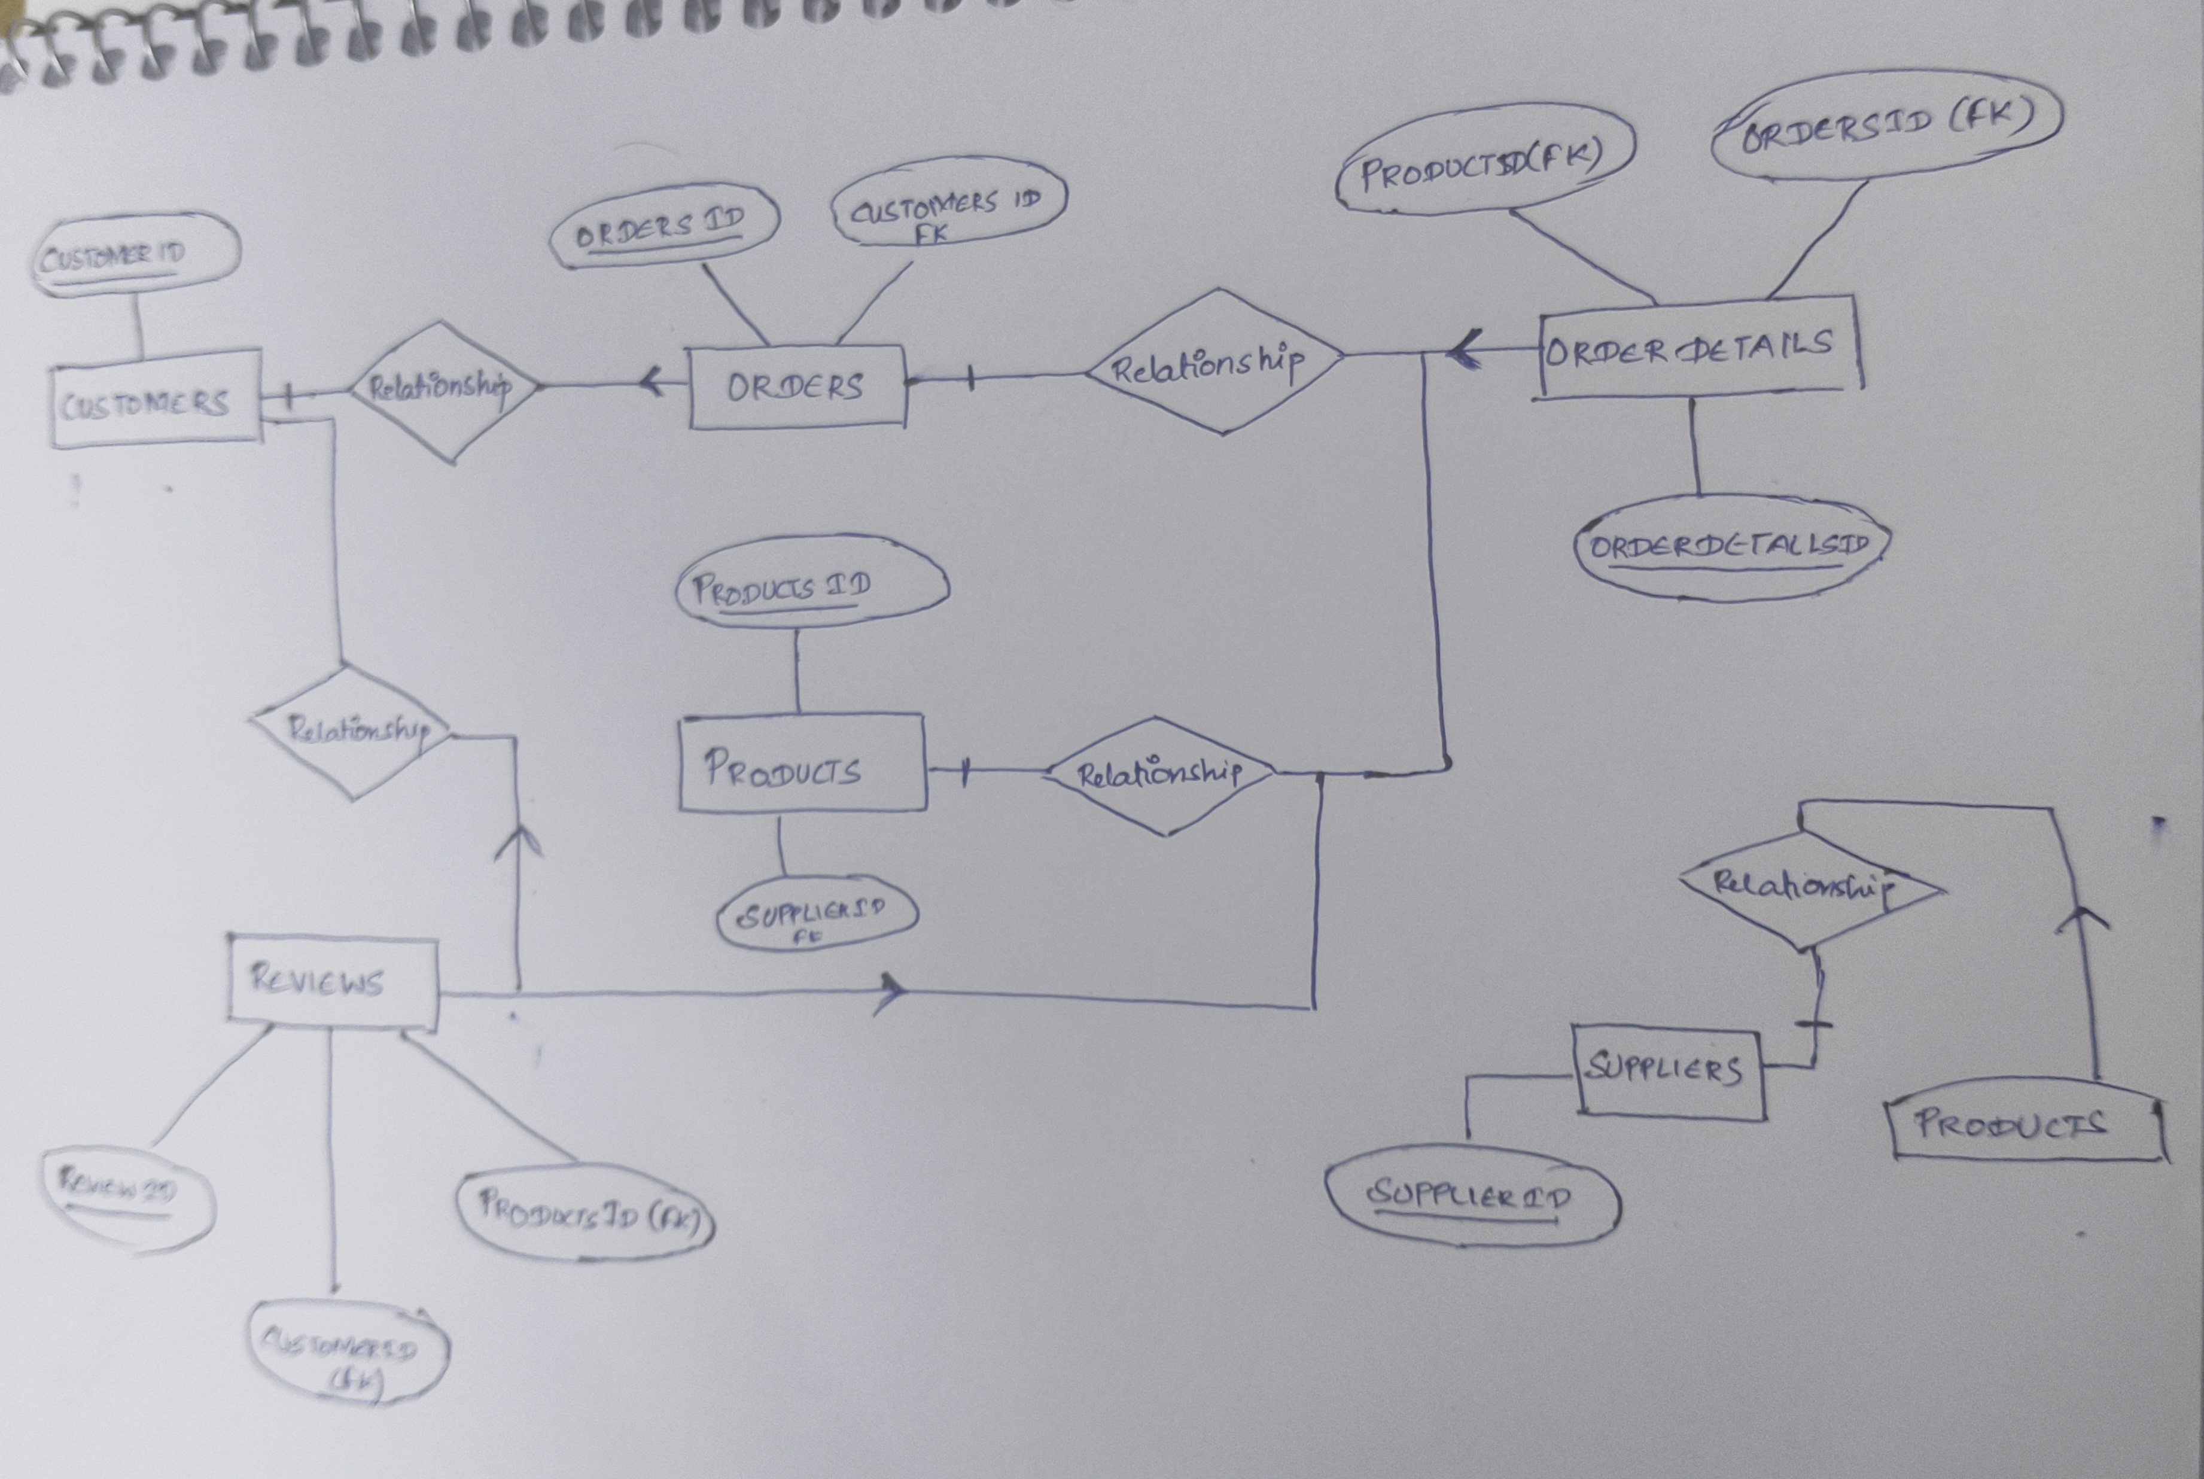
Task 1: Entity Relationship Diagram(ER): all tables

Slide 7
Task 2: Primary and Foreign key Identification:
SNO | Table Name | Primary Key | Foreign key
1 | Customers | CustomerID | NA
2 | Orders | OrderID | CustomerID
3 | Suppliers | SupplierID | NA
4 | Products | ProductID | SupplierID
5 | Reviews | ReviewID | ProductID, CustomerID
6 | Order Details | OrderDetailsID | OrderID, ProductID

Slide 8
Task 3: Write a query to:
Retrieve all customers from a specific city.
select * from customers where city='Andrewton';
Fetch all products under the "Fruits" category.
select * from products where category='Fruits';

Slide 9
Task 4: Write DDL statements to recreate the Customers table with the following constraints:
CustomerID as primary Key-- can use while table creation or as follows
ALTER TABLE customers
ADD CONSTRAINT pk_customerID PRIMARY KEY (customerID);
Ensure Age cannot be null and must be greater than 18-- can use while table creation or as follows
ALTER TABLE Customers
MODIFY age INT NOT NULL;
Add CHECK constraint to ensure age is greater than 18
ALTER TABLE Customers
ADD CONSTRAINT chk_age CHECK (age > 18);
Unique constraint for Name-- can use while table creation or as follows
ALTER TABLE Customers
ADD CONSTRAINT unique_name UNIQUE (Name);

Slide 10
Task 5: Insert 3 new rows into the Products table using INSERT statements
INSERT into products(ProductID,ProductName,Category,SubCategory,PricePerUnit,StockQuantity)VALUES('3c4688d-9b32-4630-b786-3e91eb6575a5','Certainly Baker','Bakery','Sub-Bakery-4','506','383');
INSERT into products(ProductID,ProductName,Category,SubCategory,PricePerUnit,StockQuantity) VALUES('3c4694g-9c45-4638-b796-3e81eb6575z6','Thus Snack','Snacks','Sub-Snacks-4','607','380');
INSERT into products(ProductID,ProductName,Category,SubCategory,PricePerUnit,StockQuantity) VALUES('3c4702k-9d56-4644-b806-3e71eb6575m7','Activity Snack','Snacks','Sub-Snacks-2','300','375');

Slide 11
Task 6: Update the stock quantity of a product where ProductID matches a specific ID.
Update products set StockQuantity ='100' where productID ='11dc08ec-ef6f-43d0-abaa-414a9c336956';

Slide 12
Task 7: Delete a supplier from the Suppliers table where their city matches a specific value.
Delete supplier
where city='Adamsshire';

Slide 13
Task 8: Use SQL constraints to:
Add a CHECK constraint to ensure that ratings in the Reviews table are between 1 and 5.
ALTER TABLE Reviews
ADD CONSTRAINT chk_ratings CHECK (ratings BETWEEN 1 AND 5);
Add a DEFAULT constraint for the PrimeMember column in the Customers table--Can be given during table creation
ALTER TABLE Customers
ALTER COLUMN PrimeMember SET DEFAULT NO;

Slide 14
Task 9: Write queries using:
WHERE clause to find orders placed after 2024-01-01.
Select * from orders where orderdate >'2024-01-01';
HAVING clause to list products with average ratings greater than 4.
Select productId, avg(rating) as avg_rating from reviews group by productID having avg_rating > 4;

Slide 15
Task 9: Write queries using:
GROUP BY and ORDER BY clauses to rank products by total sales.
SELECT products.productName, COUNT(order_details.productID/quantity) AS total_sales
FROM products
LEFT JOIN order_details
ON products.productID = order_details.productID
GROUP BY products.productName
ORDER BY total_sales DESC;

Slide 16
Task 11: Use SQL to :
Join the Orders and OrderDetails tables to calculate total revenue per order
select orders.orderID, ((quantity*unitprice)-discount) as sales_revenue
from orders left join order_details
on orders.orderID = order_details.orderID
group by orders.orderID
order by sales_revenue;

Slide 17
Task 11: Use SQL to :
Identify customers who placed the most orders in a specific time period.
SELECT Customers.CustomerID, Customers.Name, count(orderId) as total_orders
from orders join customers
on orders.CustomerId=Customers.customerId
where orderDate ='2025-01-01'
group by customers.customerId,Customers.Name
order by total_orders desc;

Slide 18
Task 11: Use SQL to :
Find the supplier with the most products in stock.
SELECT Suppliers.supplierID, Suppliers.supplierName, max(StockQuantity) as Maxstock
from products join Suppliers
on Suppliers.supplierID=products.supplierID
group by Suppliers.supplierID, Suppliers.supplierName
order by Maxstock desc;

Slide 19
Task 13: Write a subquery to:
Identify the top 3 products based on sales revenue.
Select productName, productID from products where
productID IN
(select productID, sum((quantity * unitprice)-discount) as sales_revenue
from order_details
group by productID
order by sales_revenue desc)
limit 3;

Slide 20
Task 13: Write a query to:
Find customers who haven’t placed any orders yet
select customerID, Name
from customers
where customerID NOT IN (select customerID from orders);

Slide 21
Task 14: Provide actionable insights:
Which cities have the highest concentration of Prime members?
SELECT city, Count(primemember) AS Highconcenteration
FROM customers
GROUP BY city
ORDER BY Highconcenteration desc;

Slide 22
Task 14: Provide actionable insights:
What are the top 3 most frequently ordered categories?
SELECT category, count(category) as category_count
FROM products
LEFT JOIN order_details
ON products.productID = order_details.productID
GROUP BY category
ORDER BY category_count desc
LIMIT 3;

